Slide 1
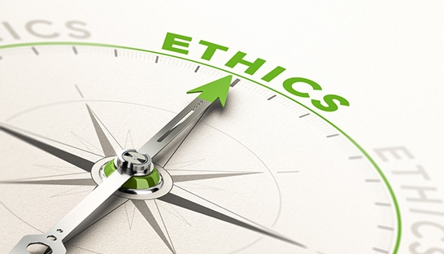
IN DATA SCIENCE

Slide 2
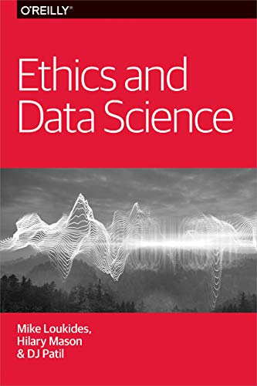
Learn how to think through the ethics surrounding privacy, data sharing, and algorithmic decision-making.
Who owns data
How we value different aspects of privacy
How we get informed consent
What it means to be fair

Slide 3
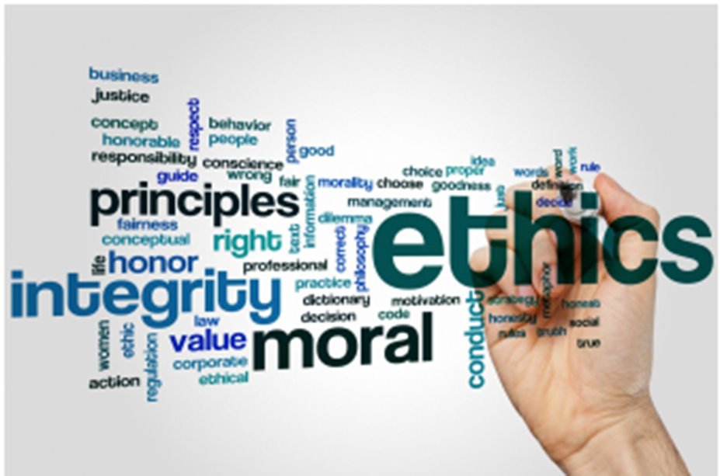
What are Ethics?
Ethics describe a code of behavior (what is right and wrong).
They are shared value / societal rule
Ethic is not law
No philosophical questions, but ethical practice of Data Science
Data ethics encompass the following: Data Handling: generation, recording, curation, processing, dissemination, sharing, and use. Algorithms: AI, artificial agents, machine learning, and robots.

Slide 4
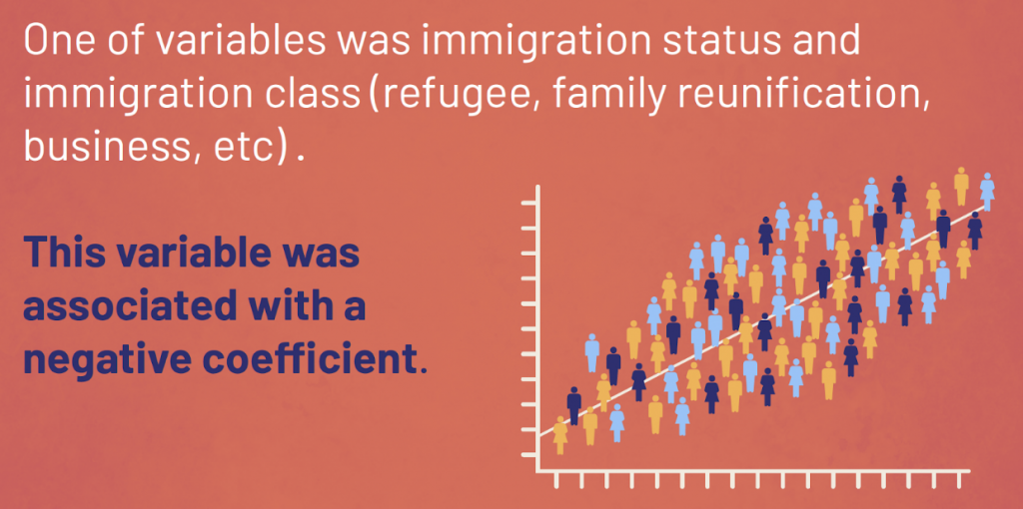
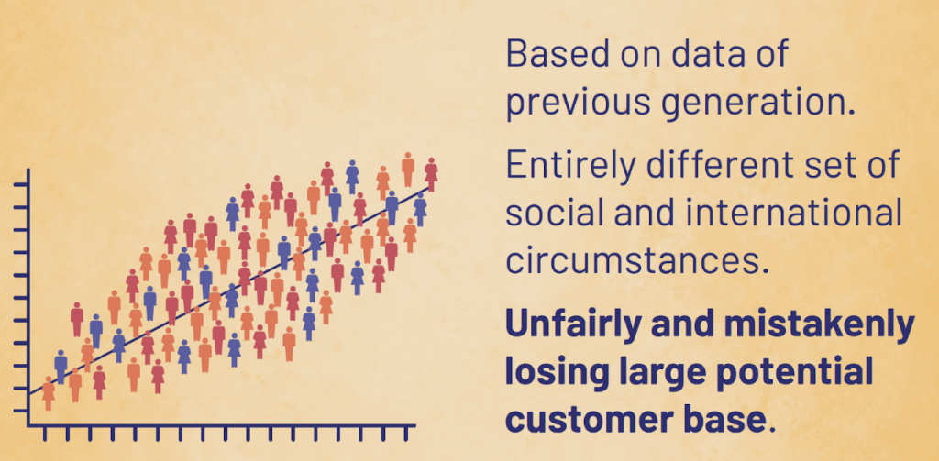
Why Ethics in Data Science is Important?
Making decisions about consumer credit
In financial institution - To determine if people qualify for credit – use demographic data → traditional machine learning algorithm.
this was an unethical decision
Data used incorrectly can also cause unintended harm.
Notes:
The company included a parameter for an applicant’s immigration status and immigration type as part of the process of ranking applications. The “learning” this algorithm had done was on historic data. And that old, out-of-date data told the company that people of specific immigration profiles were a bad risk. It said they shouldn’t be offered good credit.
This decision was using assumptions from the data of a previous generation. A generation with a vastly different set of social circumstances in a time when the world was very different. By relying on this out-of-date data, they were unfairly denying certain groups credit — and inadvertently rejecting a large potential customer base.
This was an unethical decision, not only is it unethical to make decisions about people’s lives based on outdated social profiling, but it is terrible for profits.

Slide 5
Instances of high-impact and high-profile data science research that has resulted in flawed or inaccurate findings, as well as ethical and legal quandaries.
A few examples are listed here:
Inaccurate predictions of flu trends. In 2013, Google Flu Trends over-predicted true influenza-related doctors’ visits as determined by the Centers for Disease Control and Prevention. This has been primarily attributed to overreliance on outdated models (Butler, 2013).
Release of personally identifiable data. The abundance of data available on individuals from companies and social media can present ethical dilemmas to researchers in terms of privacy, scalability of results, and subject participation agreement. For instance, a 2013 study linking numerous Twitter users to sensitive information from their financial institutions prompted discussions of when researchers should be required to obtain written consent when using nominally publicly accessible information (Danyllo et al., 2013).
Biases in predictive policing. There is much debate over the use and appropriateness of predictive policing—the use of data science by law enforcement to predict crime before it occurs. There is no consensus yet on the effectiveness of this methodology, and civil liberties groups argue that the data used to develop (i.e., train) the models are inherently biased (Hvistendahl, 2016).
Surveillance of citizens. China is deploying facial recognition technologies as well as other data science approaches to track individuals and influence behavior. The national goal is to link these surveillance systems by 2020 to “implement a national ‘social credit’ system that would assign every citizen a rating based on how they behave at work, in public venues, and in their financial dealings” (Chin and Lin, 2017).
Bad Data and Bad Models lead to bad decisions
https://www.nap.edu/read/25104/chapter/4#15

Slide 6
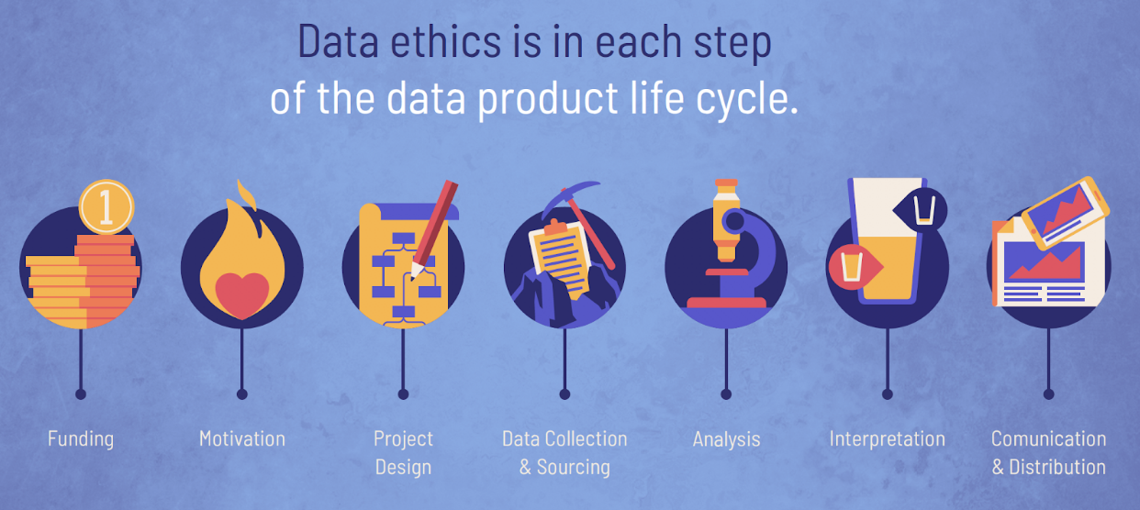
Why Ethics in Data Science is Important?
Ethics in data science must be considered and included in every one of the seven steps of the data lifecycle.
https://idatassist.com/are-ethics-in-data-science-really-that-important

Slide 7
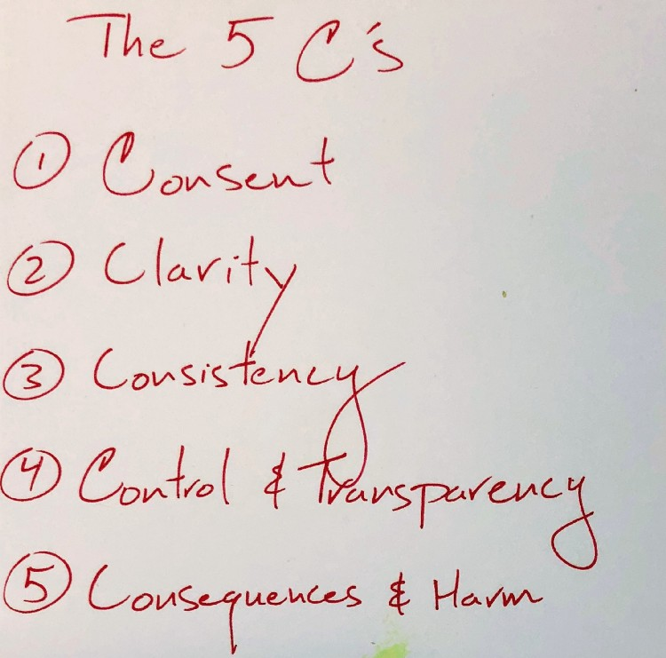
Five (5) framing guidelines help us think about building data products
They’re a framework for implementing the golden rule for data.
Take a look at them one at a time:
https://www.oreilly.com/radar/the-five-cs/

Slide 8
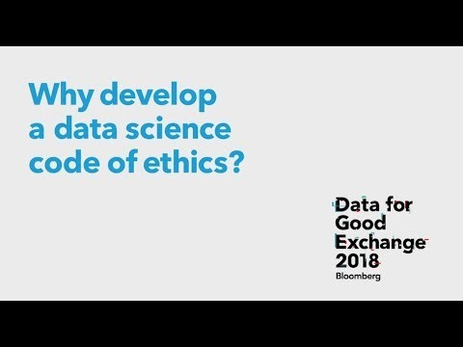
https://www.youtube.com/watch?v=s8qjmImu1LQ

Slide 9
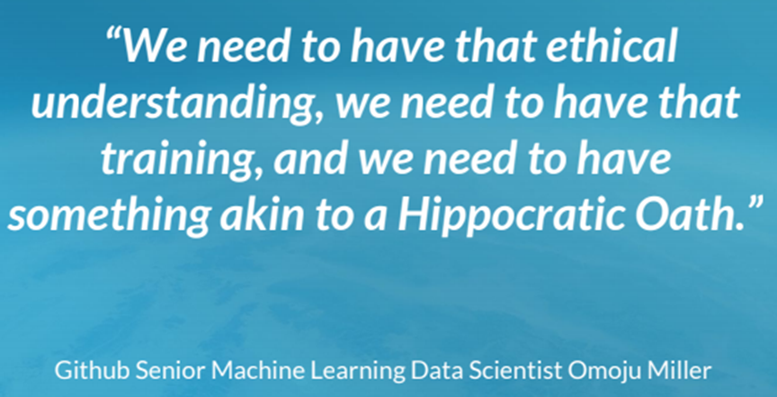
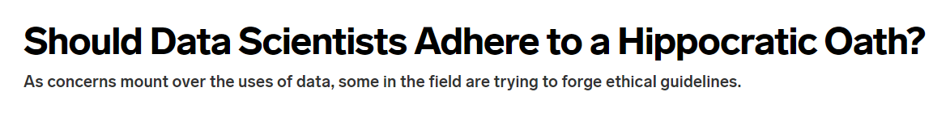
Existing Ethical Codes Addressing Data
ACM http://ethics.acm.org/code-of-ethics/
IEEE https://www.ieee.org/about/compliance.html
ASA https://www.amstat.org/ASA/Your-Career/Ethical-Guidelines-for-Statistical-Practice.aspx
Need a consensus that ethical standards need to come form within data science itself, as well as from legislators, grassroots movements and other stakeholders.
https://www.wired.com/story/should-data-scientists-adhere-to-a-hippocratic-oath/

Slide 10
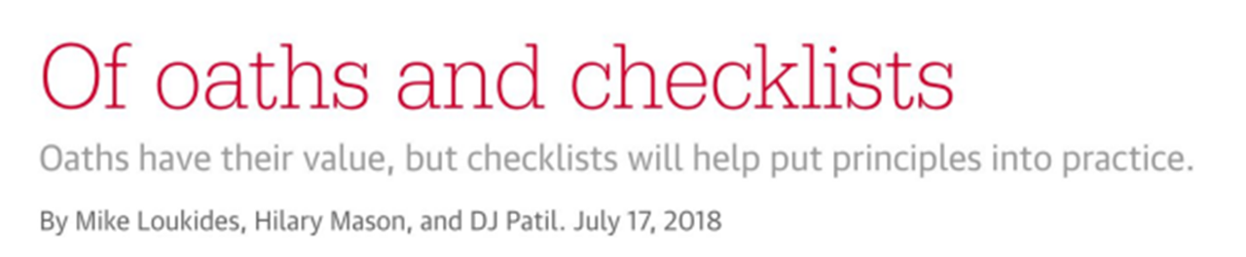
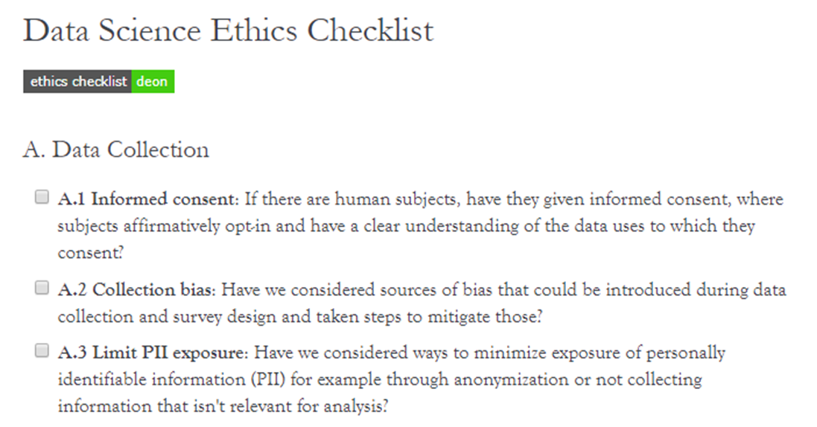
DrivenData has put together Deon, a command line tool, that allows you to easily add an ethics checklist to your data science projects.

Slide 11
Perhaps no area of ethics in data science has received more attention today than the protection of personal data.
The digital transformation of our interactions with social and economics communities defined us by what we search for on the internet, what we eat, where we travel to, where we hold membership accounts, etc.
Organizations and individuals can leverage this data to uncover powerful findings.

Slide 12
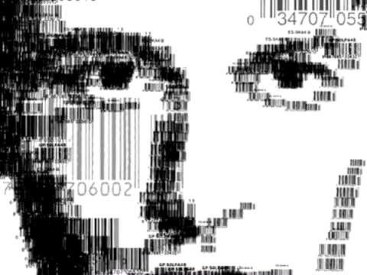
Digital Footprint
Digital footprint or digital shadow or digital dossier refers to one's unique set of traceable digital activities, actions, contributions and communications manifested on the Internet or on digital devices. (Wikipedia)
https://youtu.be/79IYZVYIVLA

Slide 13
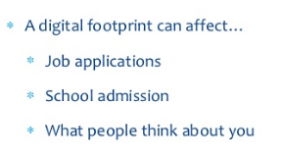
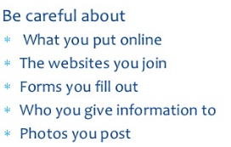

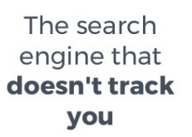
To reduce their digital footprint

Slide 14
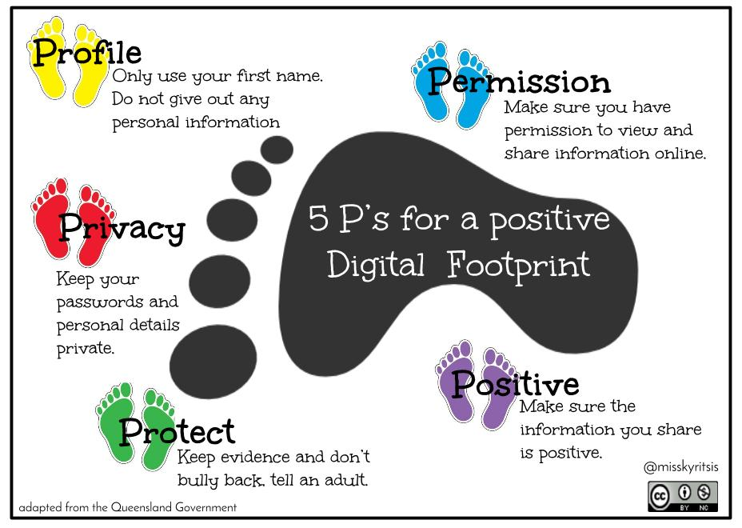

Slide 15
The Explicit and Implicit Digital You
Your implicit footprint relates to data points that you are not fully aware of. This includes data coming from almost any digital application or device you are engaging with. Examples range from tracking technology (e.g. online tracking or mobile location tracking) and engagement data for content filter algorithms (e.g. using page views to understand what topics you are interested in) to engagement data for advertisement and purchase data for item recommendations (e.g. Amazon’s Product recommendation).
Your explicit footprint is easier to get a hold of. It relates to data you can find and, in some cases, you can control. Explicit footprint data typically relates to profile pages, likes, comments, purchase histories etc.
A simple test to check your explicit footprint is to search for your name in a search engine. The higher up the page is the more explicit your footprint on the given page or application is.

Slide 16
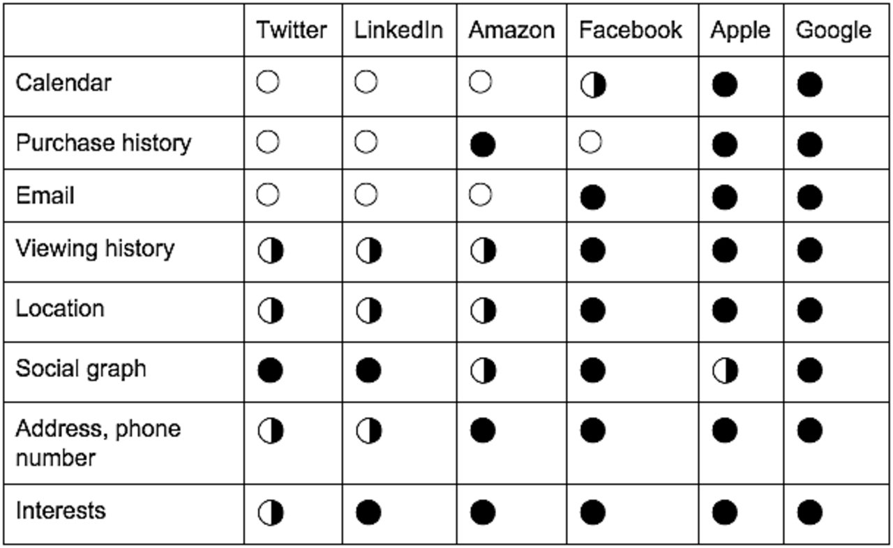
The Explicit vs Implicit Digital You
https://dri.es/winning-back-the-open-web

Slide 17
Ethics Matters
Data Science has great power---to harm and to help.
Data Scientists must care about how this power is used
– Cannot hide behind a claim of “neutral technology”.
We are all better off if we voluntarily limit how this power is used.
Ethical Analysis Is Difficult - In a complex world, with many actors, it is often not easy to see where the problem lies and how to define limits to the use of Data Science.

Slide 18
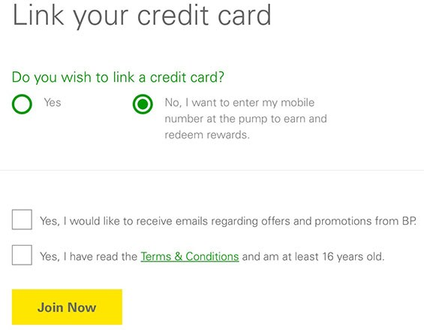
Informed Consent
Data / Human subjects must be
Informed about the experiment / intended use & purpose of data collected
Consent to the experiment / use of data
Voluntarily
Must have the right to withdraw consent at any time

Slide 19
Data Ownership
Most of the time you don’t own the data about you. The data belongs to the company who collected it.
Nevertheless we might have some control over these data that aren’t ours because they are about us.
We need to create the principle to reason about this control and that’s the main concern of a discussion about the right to privacy.
If the company goes bankrupt, the company buying it should keep the same privacy.

Slide 20
Privacy
Privacy is a basic human need.
Even for people who have nothing to hide!
Privacy, of course is the first concern that comes to so many minds when we talk about Big Data.
How do we get the value we would like by collecting, linking, and analyzing data, while at the same time avoiding the harms that can occur due to data about us being collected, linked, analyzed, and propagated?
In the past, one could get a fresh start by:
moving to a new place
waiting till the past fades (reputation can rebuild over time)
Big Data is universal and never forgets.
Data Science results in major asymmetries in knowledge.

Slide 21
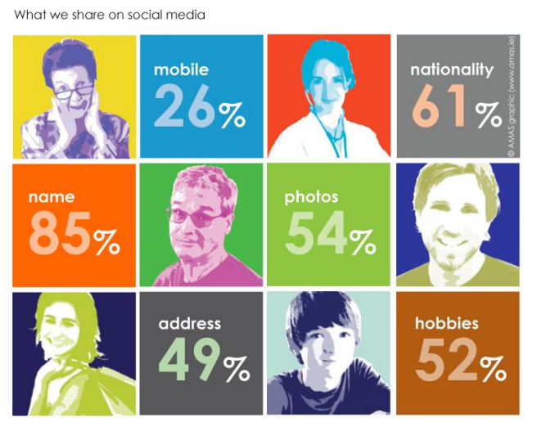

Slide 22
WayBack Machine
The Wayback Machine is a digital archive of the World Wide Web and other information on the Internet. It was launched in 2001 by the Internet Archive, a nonprofit organization based in San Francisco.
Archives pages on the web (https://archive.org/web/ - 300 billion pages saved over time)
almost everything that is accessible
should be retain forever
If you have an unflattering page written about you, it will survive for ever in the archive (even if the original is removed).

Slide 23
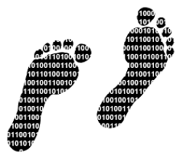
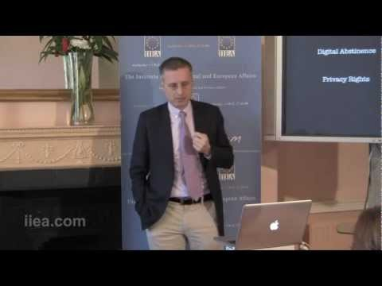
Right to be forgotten
Laws are often written to clear a person’s record after some years.
What you leave behind when you are online / use apps?
Viktor Mayer Schönberger on The Right to be Forgotten
https://www.youtube.com/watch?v=9Xpk26bJ7FU
The right to silence on past events in life that are no longer occurring. The right to be forgotten leads to allowing individuals to have information, videos, or photographs about themselves deleted from certain internet records so that they cannot be found by search engines.

Slide 24
Collection vs Use
Privacy is usually harmed only upon use of data
Collection is a necessary first step before use
Existence of collection can quickly lead to use
But collection without use may sometimes be right
e.g. surveillance
By the time you know what you need, it is too late to go back and get it

Slide 25
Loss of Privacy
Due to loss of control over personal data
I am ok with you having certain data about me that I have chosen to share with you or that is public, but I really do not want you to share my data in ways that I do not approve.
“Waste” Data Collection
Your ID is taken at the club (Name, address, age)
• How this data is being used ? Is it stored ?
E.g phone call, metadata includes
• Caller
• Callee
• Time of Date of Call
• Duration & Location
Meta Data

Slide 26
Underestimating Analysis
A smart meter at your house can recognize “signatures” of water use every time you flush the toilet, take a shower, or wash clothes.

Slide 27
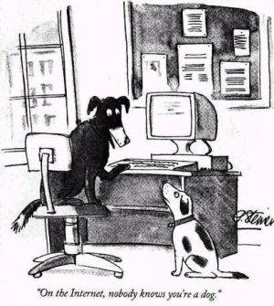
Anonymity
Anonymity has, and always will be, at the heart the Internet.
As the famous 1993 New Yorker cartoon illustrates:
You can say whoever you are
You can say whatever you are
You can make up a persona
When we talk about anonymity online we refer to the fact that messages posted anonymously cannot be linked back to the offline identity of the sender.
A key identifier that follows us as we navigate online is our IP address
Only a few platforms, such as Tor, cannot be tracked.

Slide 28
Many transactions need ID
Anonymity is quite impossible
You must provide an address to receive goods.
You must give your name for travel booking.
You must reveal your location to get cellular service.
You must disclose intimate details of your health care and lifestyle to get effective medical care.
Anonymity is virtually impossible, with enough other data
Face can be recognised in image data

Slide 29
Case Study
The Princeton Dialogues on AI and Ethics has released six long-format case studies exploring issues at the intersection of AI, ethics and society.
https://aiethics.princeton.edu/case-studies/case-study-pdfs/

Slide 30

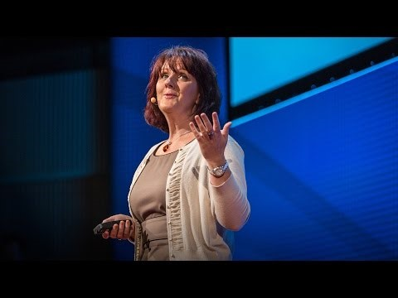
The ethics of collecting data (10:17 mins)
https://www.ted.com/talks/marie_wallace_the_ethics_of_collecting_data

Slide 31
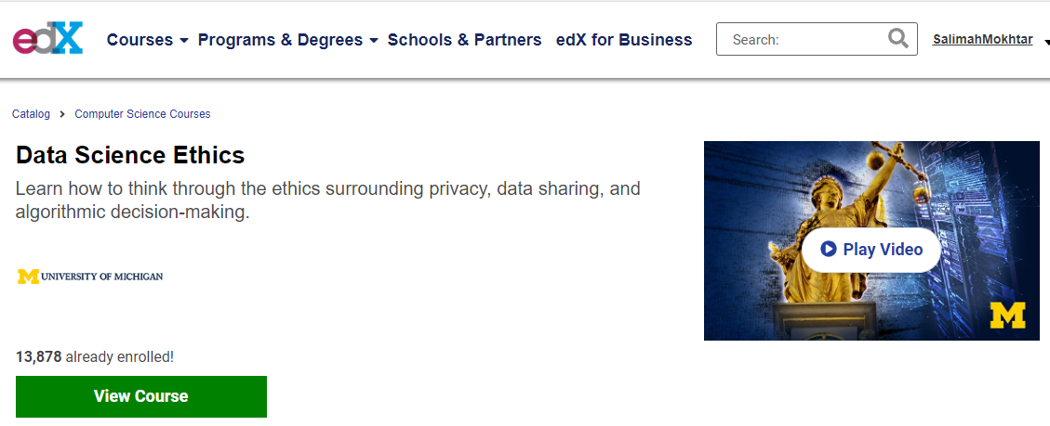
Resources:
https://www.slideshare.net/HJvanVeen/ethics-in-data-science-and-machine-learning
Take this course

Slide 32
